Slide 1


Team 29: Shoe AR
Bi-Weekly Update 4 Santiago Cantu, Alvaro Espinoza, Ulises Aguilera, Brandon Smith Sponsor: Pranav Dhulipala TA: Eric Robles

Slide 2

Executive Summary
Problem Statement:
Online shopping has no manner of ensuring the correct size
No way of seeing how a shoe looks on your foot
Our App Will:
Measure the size of your foot and provide you with the correct shoe size
Provide a live visual of how the shoe would look on your foot

Slide 3
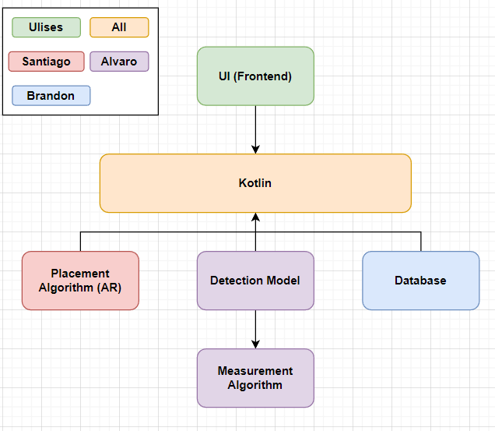
System Block Diagram
UI:​
Storefront
Camera
Kotlin:​​
Information transfer
Database:​
Shoe models
Placement Algorithm:​
Superimposition
Detection Model:
Foot Detection​
Measurement Algorithm:​​
Foot size

Slide 4
Project Timeline
Subsystem Designs and Testing (completed 9/21) | Integration of Database with UI (to complete by 10/5) | Integration of ML Model and AR Camera with UI and Database (to complete by 10/19) | Final Integration (to complete by 10/26) | System Test (to complete by 10/30) | Validation (to complete by 11/2) | Demo and Report (to complete by 12/2)
Notes:
Eric

Slide 5
Database/Backend
Brandon Smith
Accomplishments since Status Update 3 20hrs | Ongoing progress/problems and plans until the next presentation
Database structure further modified to improve compatibility with app and include user data Shoe table fully integrated with frontend | Complete integration and test user data queries Assist with integration and file management of superimposition

Slide 6
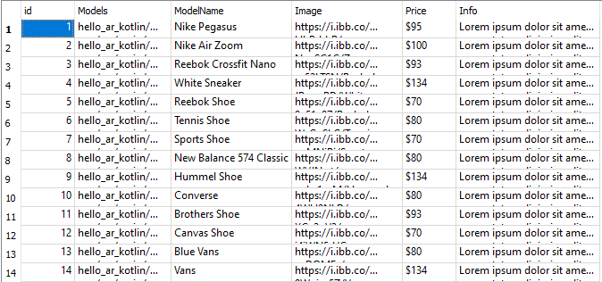
Database/Backend Brandon Smith

Slide 7
Frontend
Ulises Aguilera
Accomplishments Status Update 3 16hrs | Ongoing progress/problems and plans until the next presentation
Integrated Shoe table Began integrating AR Camera and ML Cleaned up UI | Complete User and Cart tables integration Finish integrating AR Camera and ML

Slide 8
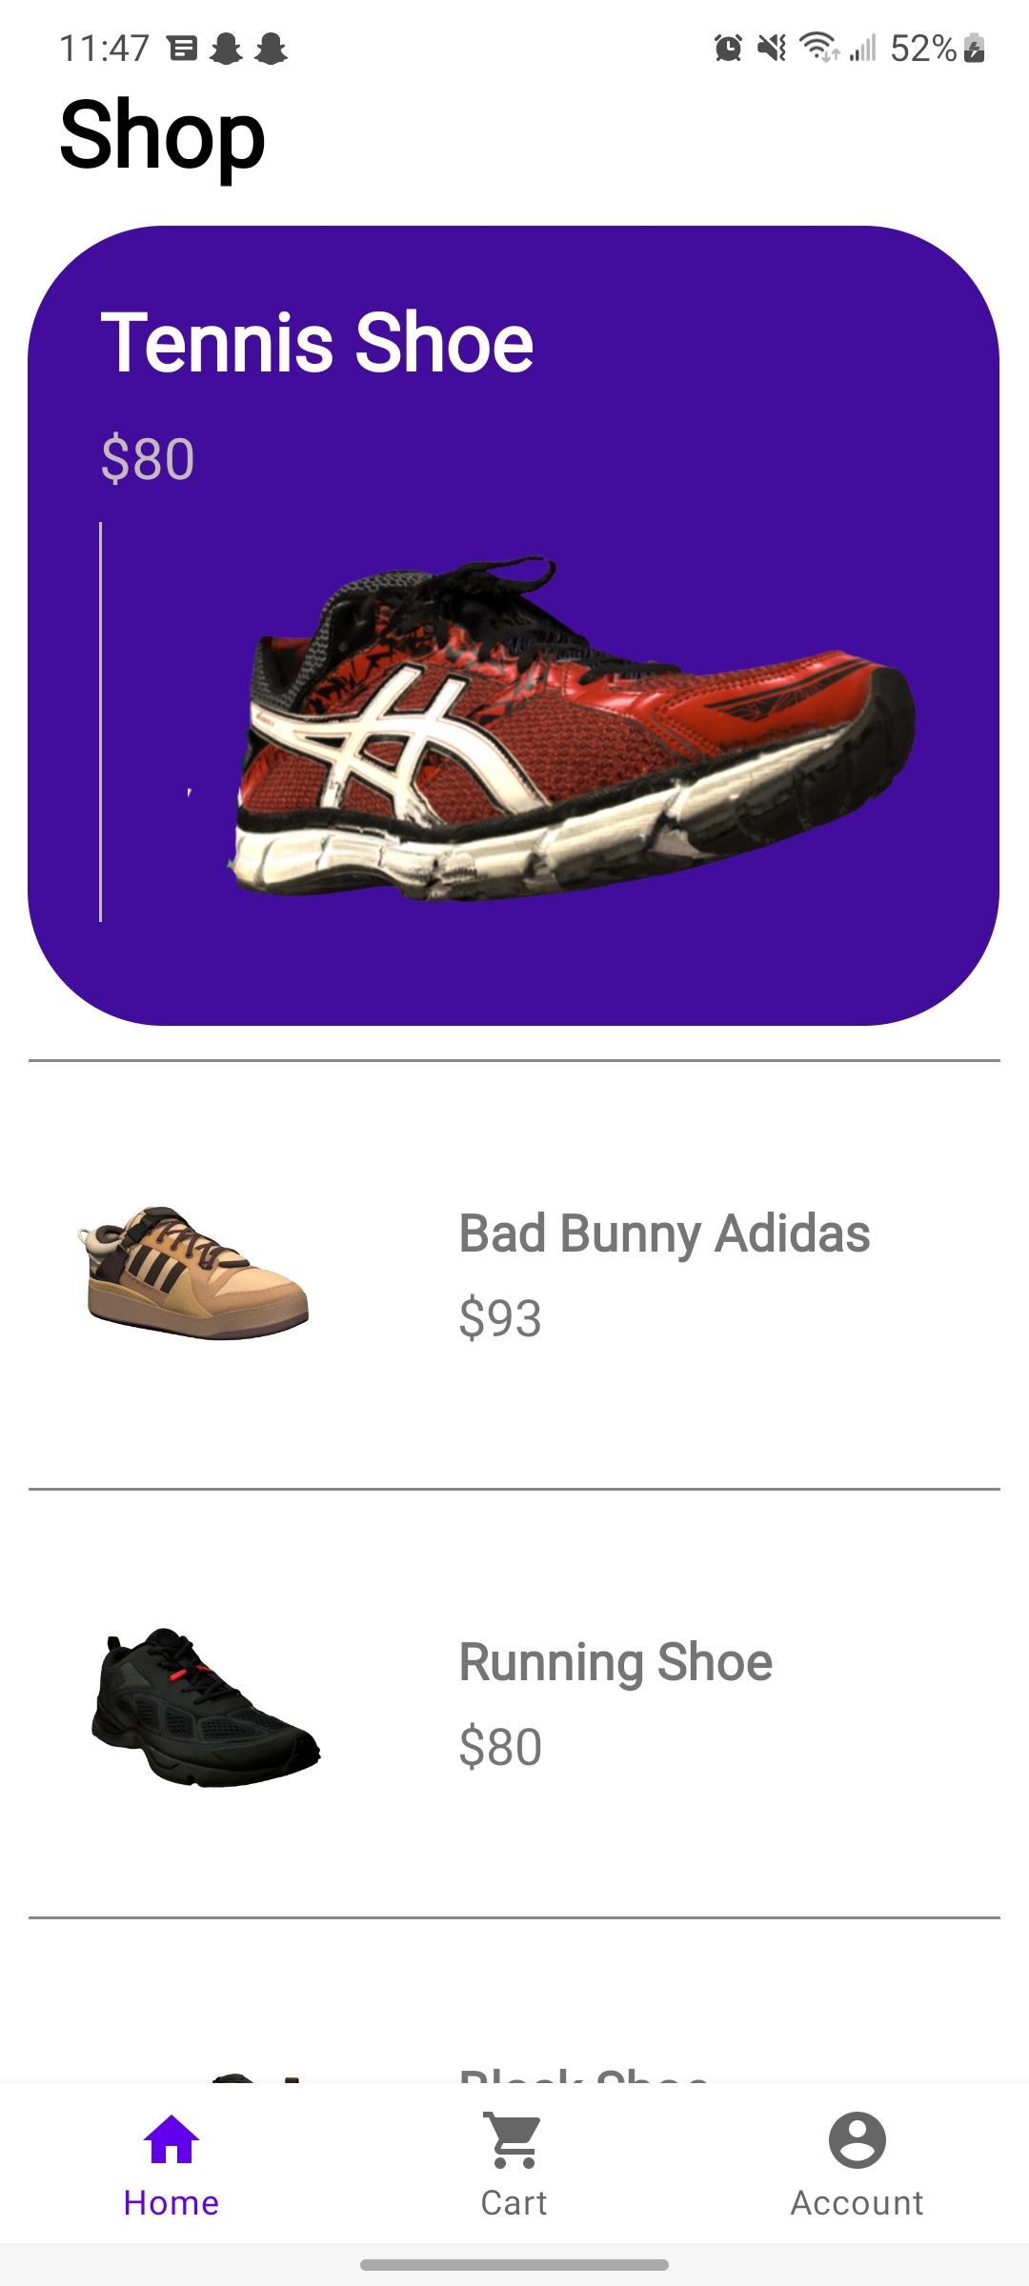
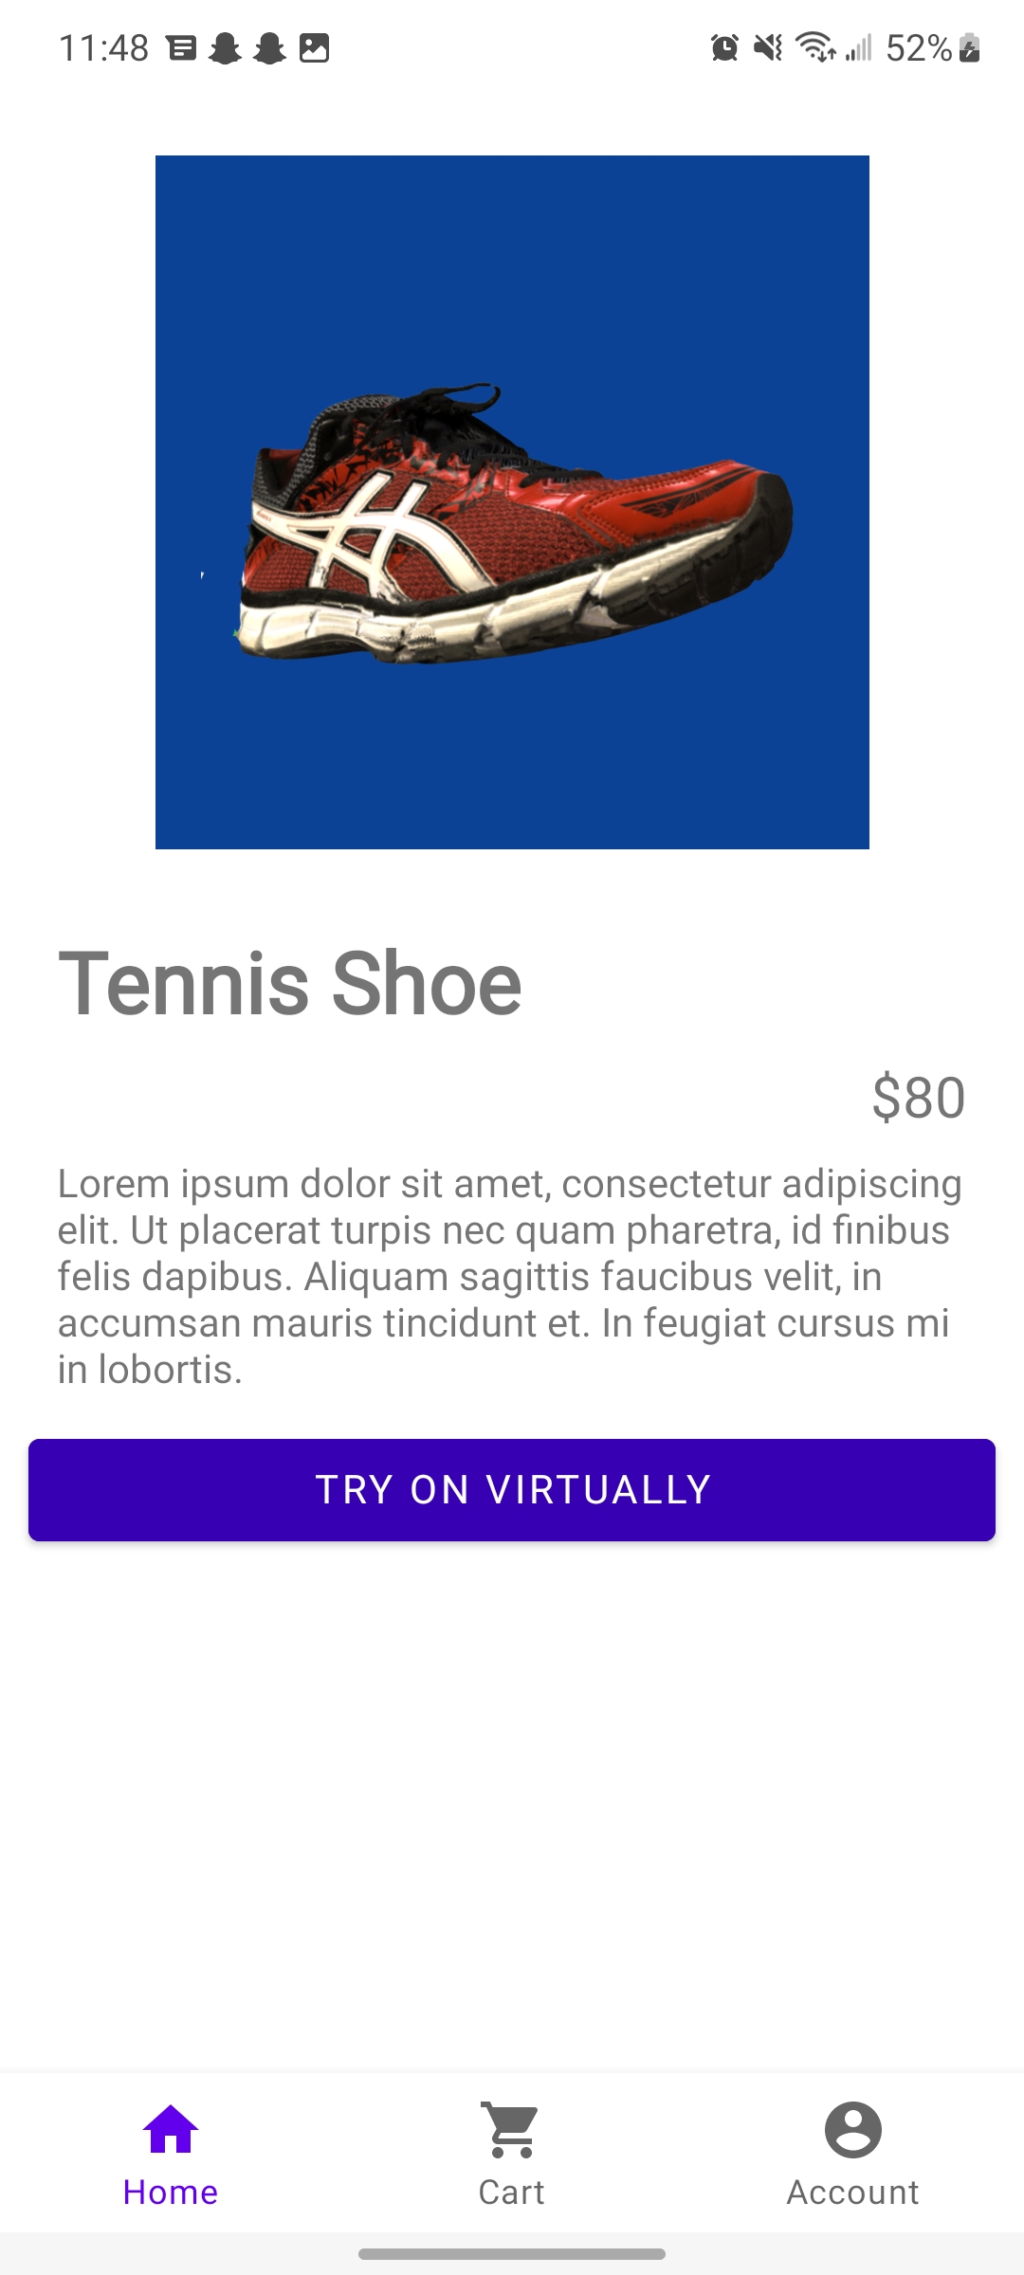
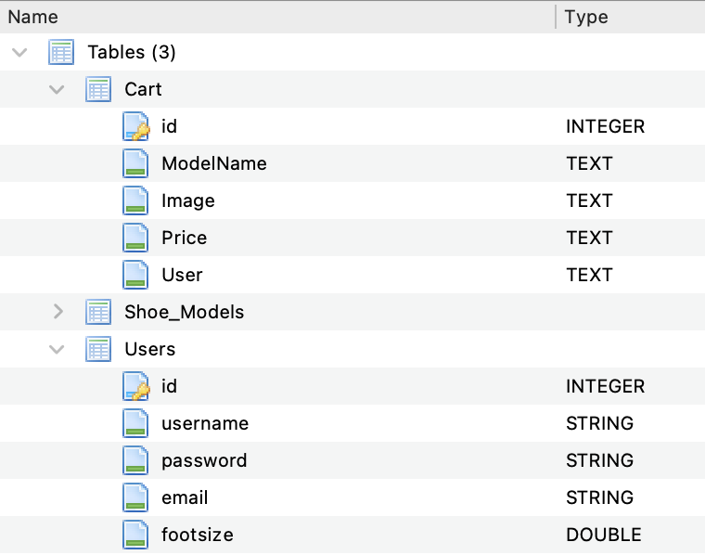
Frontend Ulises Aguilera

Slide 9
Detection Model
Alvaro Espinoza
Accomplishments since Status Update 3 12 hrs | Ongoing progress/problems and plans until the next presentation
Tested model on example TensorFlow app Ran model on physical Pixel 3 Integrating with current app build | Fix integration bugs with current app build Switch detection model architecture

Slide 10
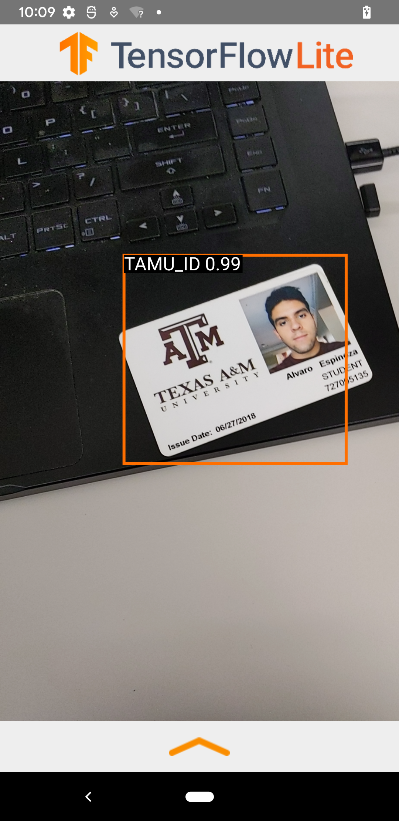
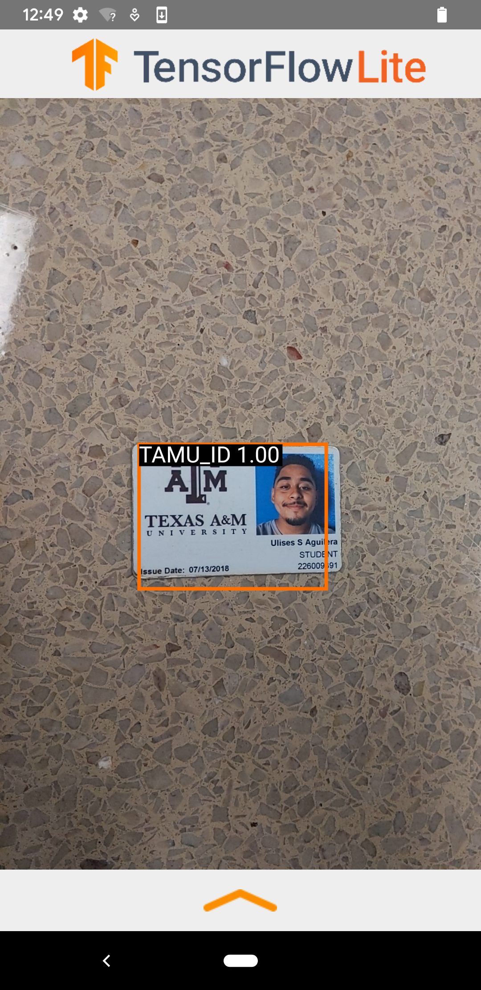
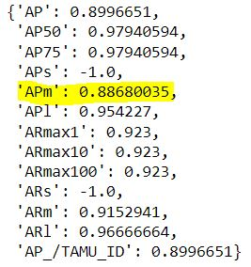
Detection Model Alvaro Espinoza

Slide 11
Shoe Superimposition
Santiago Cantu
Accomplishments since Status Update 3 16 hrs | Ongoing progress/problems and plans until the next presentation
Optimized superimposition code Resolved scaling issue Prepared for integrating with Database and Foot Detection | Ongoing integration with Database and Foot Detection Starting with Database Translating positioning data received from Foot Detection

Slide 12
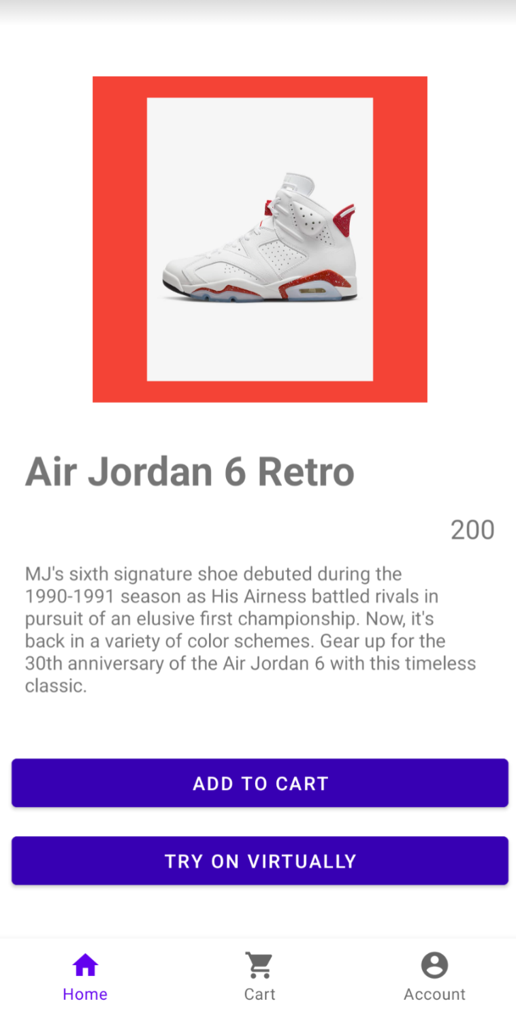
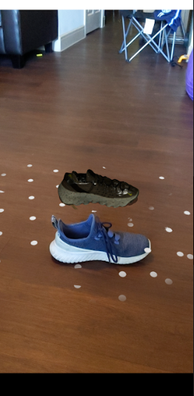
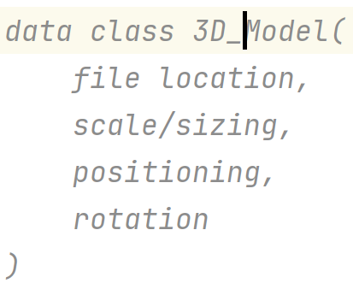
Shoe Superimposition Santiago Cantu

Slide 13
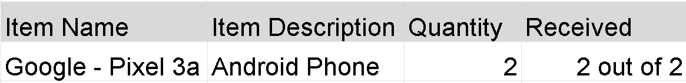
Part Ordering Status

Slide 14
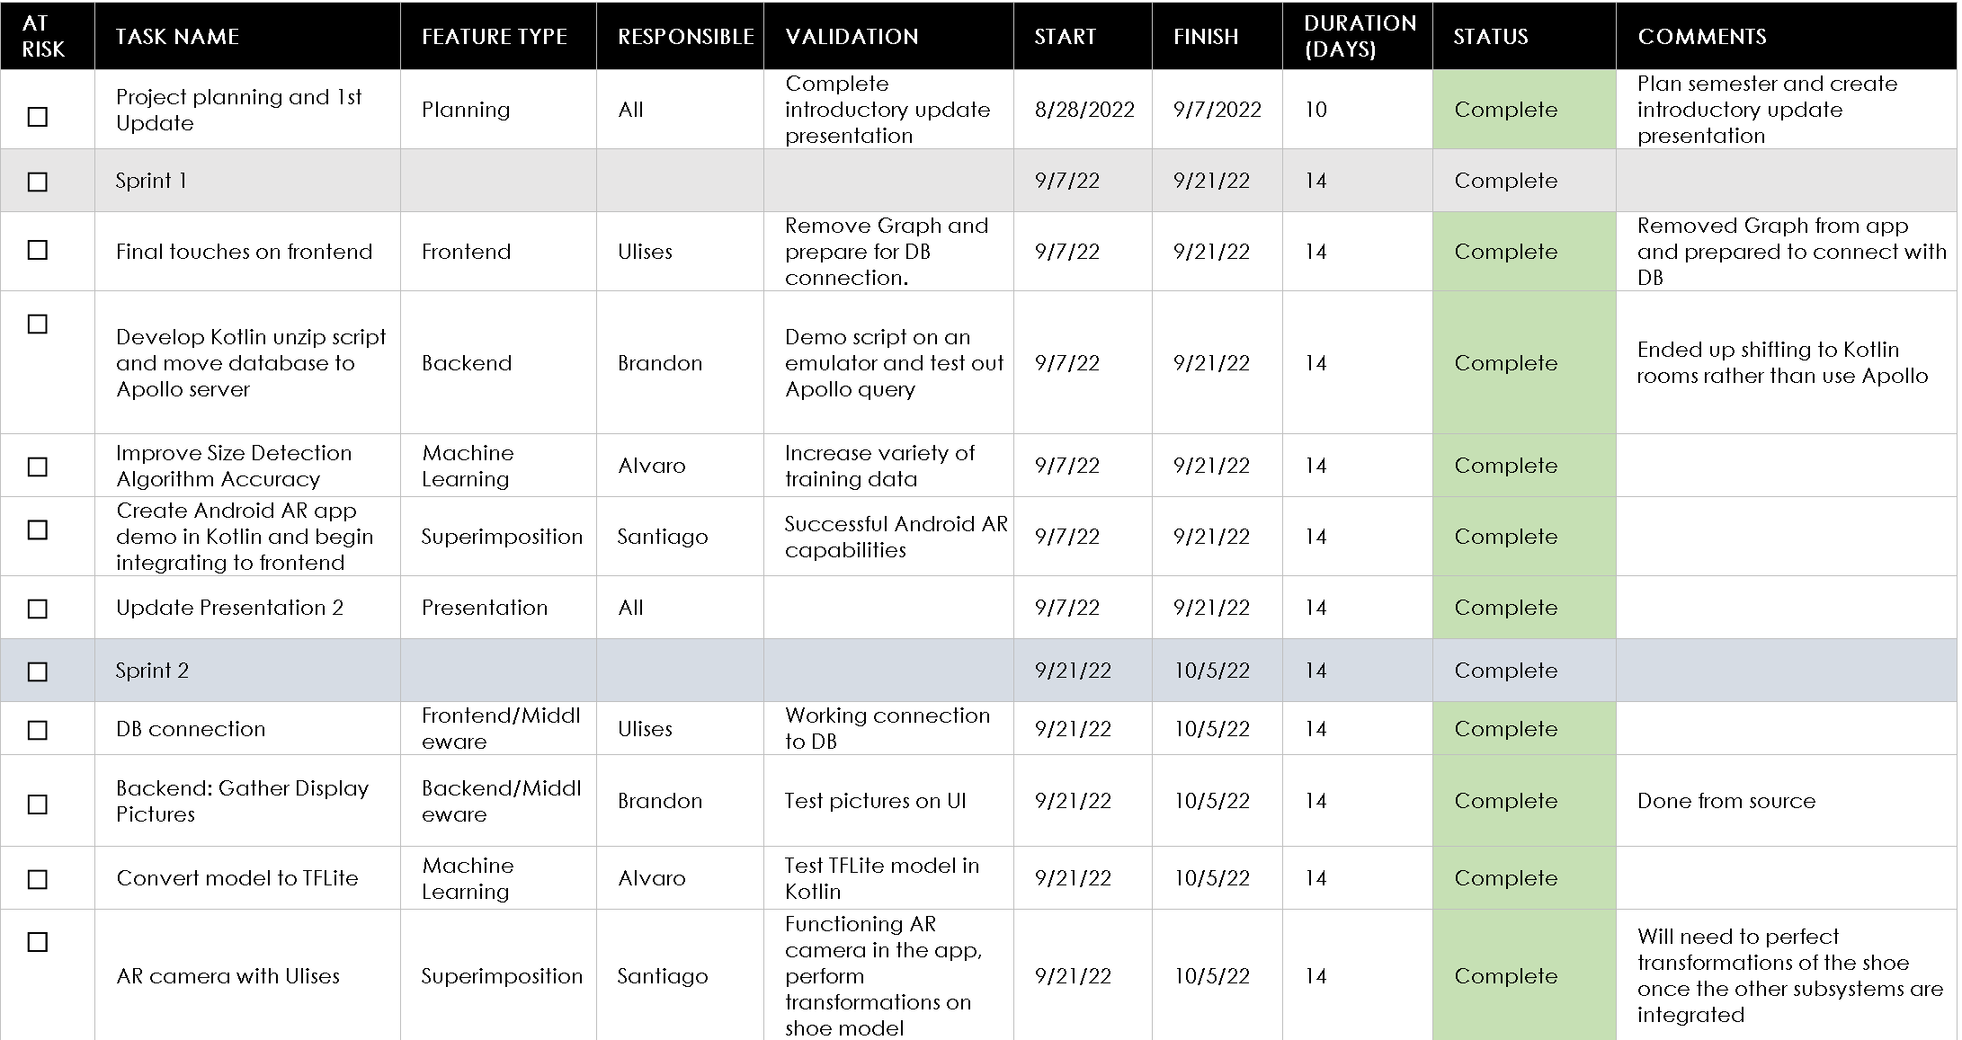
Execution & Validation Plan
Notes:
Michelle

Slide 15
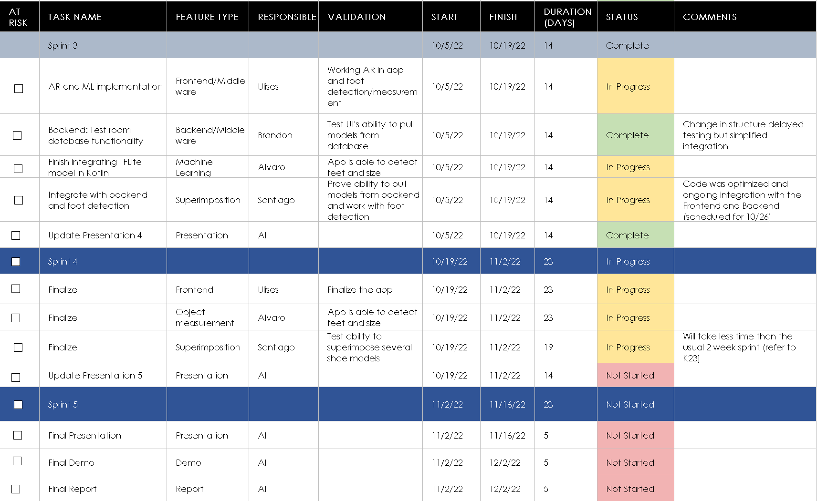
Execution & Validation Plan
Notes:
Michelle

Slide 16
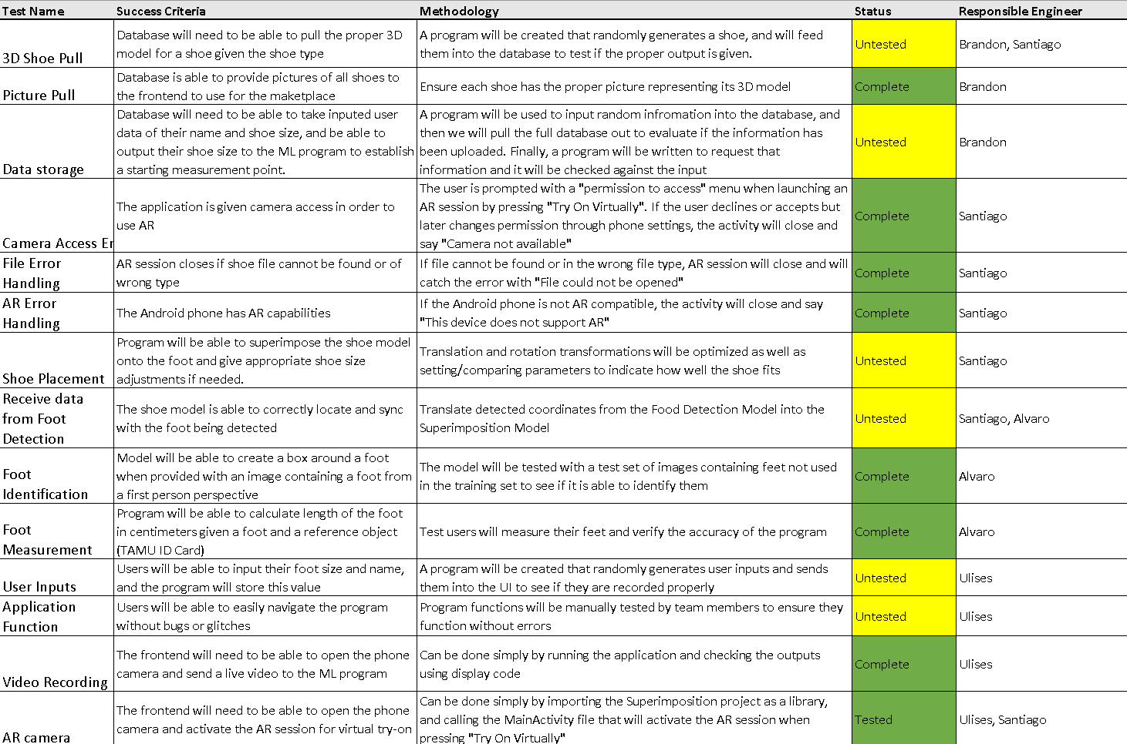
Execution & Validation Plan
Notes:
Michelle

Slide 17
Thank you!
Questions?

